Slide 1

Kaizen Competition-2024
Team Name : Success
Team Members
Rohit Pandurang Patil (Scm department)
Maheswari Mahim ( Store department)

Slide 2
Annually 36lacs rupees cost involves
Generation of plastic waste annually 18MT
More effort involves for using wrapping roll
Kaizen to save cost annual cost involve
Save the environment hazard from use of plastic
To reduce manpower efforts
Standardization and horizontal deployment in Both IBL and OBL
Improve 5’S in stores area
2

Slide 3
We were using plastic wrap roll to wrap pallet every time.
Generation of plastic waste.
Cost involves for wrapping roll is 36 Lacs per year
If we use mesh instead of wrapping roll, then we saved 16Lacs per year.
Wrapping roll Cost/Month | Wrapping roll Cost/Year | Wrapping Roll cost for 3 year
300000 | 3600000 | 1.08 Cr
Note:- This is one time investment
Price Of Mesh (per piece) In Rs | Total No Of Locations | Total cost of Mesh | Warranty | Saving Cost
2000 | 3000 | 60 Lacs | 3 years | 48 lacs
3

Slide 4

Kaizen Competition-2024
Why- Why Analysis
*(Do the why-why analysis for the implemented kaizen, If require)
Problem
Annually cost involves 36lacs for one time use plastic
Why 3
Why 1
Requirement of business to store material in warehouse
Why 1
Why 2
To run the business smoothly keep stock in warehouse
Why 3
To keep stock and avoid incident required wrapping every pallet before kept in location
Why 4
Involves 36lacs cost per annum
Why 5
To avoid this cost we replace plastic wrapping role with mesh
4

Slide 5
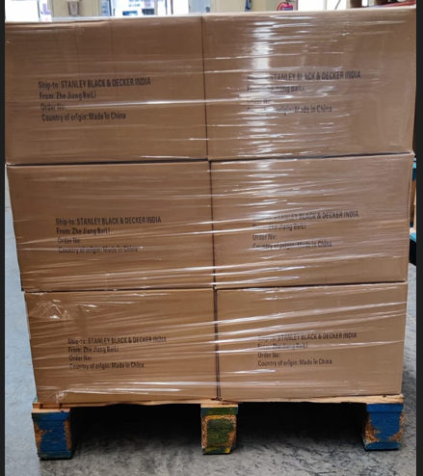
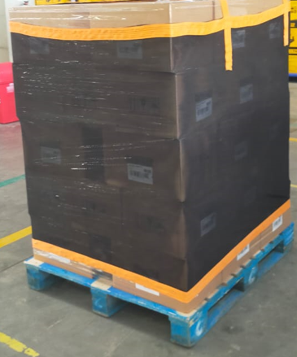
Before
After
5

